Slide 1
Travel Agency Website
~WD-11
Presented by Arshad Ahmed Shareef

Slide 2
Team Members:
1.Arshad Ahmed Shareef-160420735031
2.Aliza Gowlani-160419737065
3.Mohammed Ghouse-160419735073

Slide 3
Technology Used.
1.Html
2.Css
2.1:Glassmorphism

Slide 4
RESOURCES:
1.Icons:IonicIcons.com
2.Images:Unsplash.com, pixel.com

Slide 5
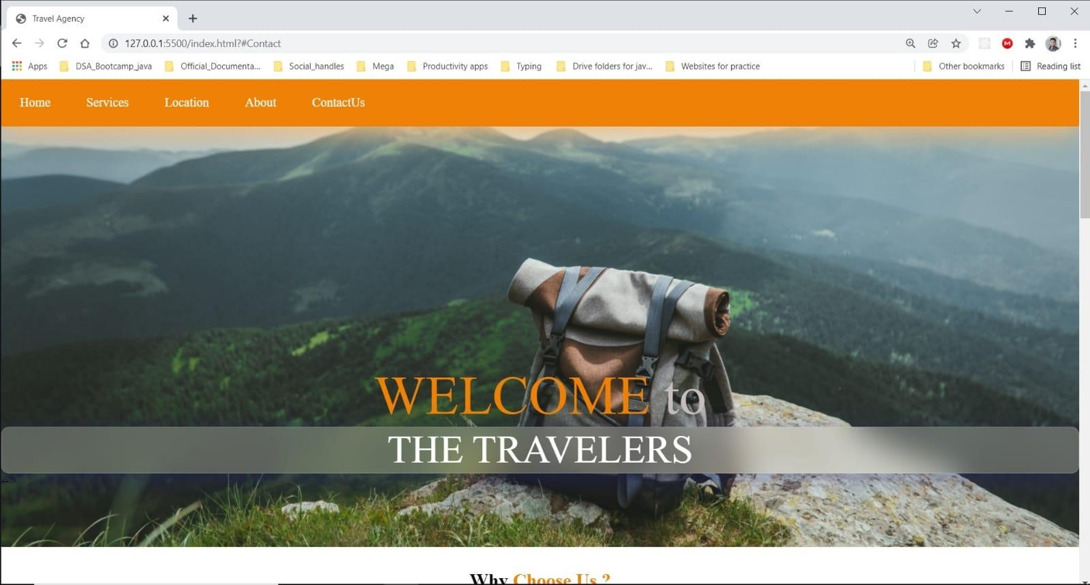
Output :

Slide 6
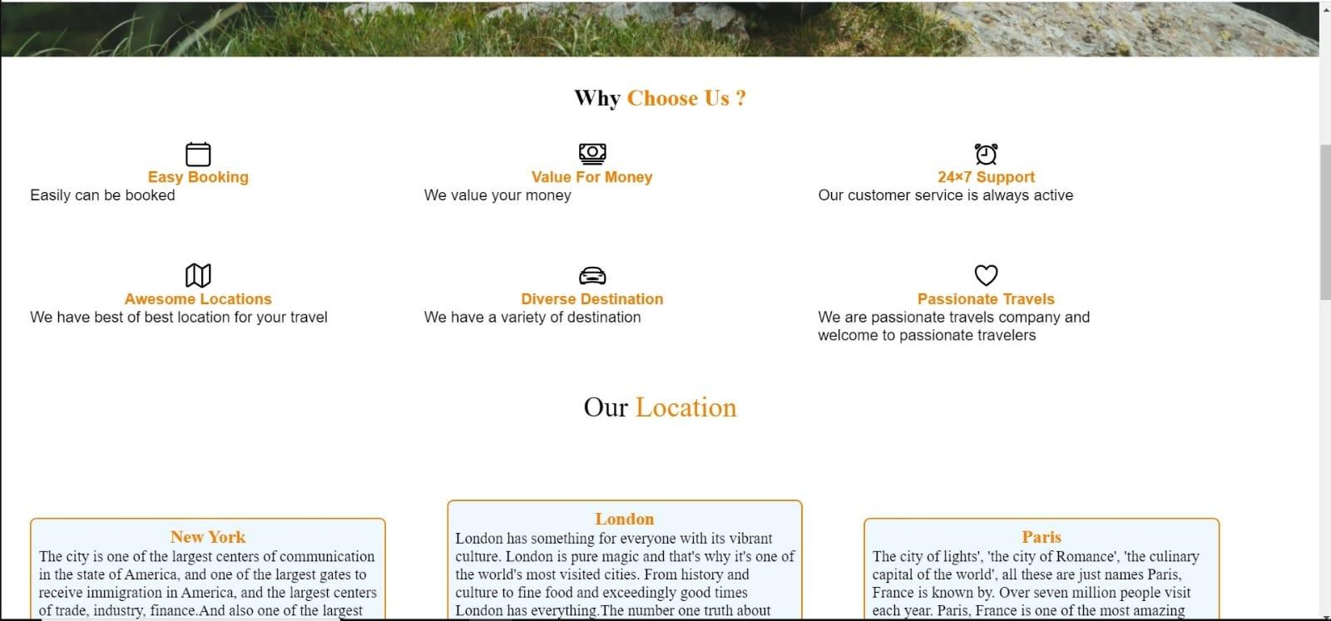

Slide 7
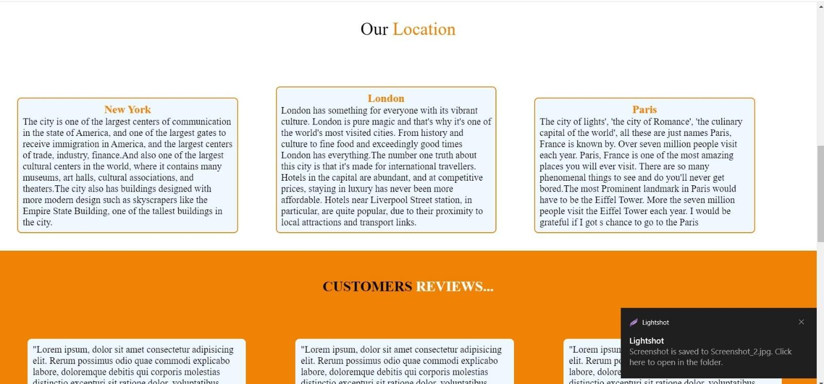

Slide 8
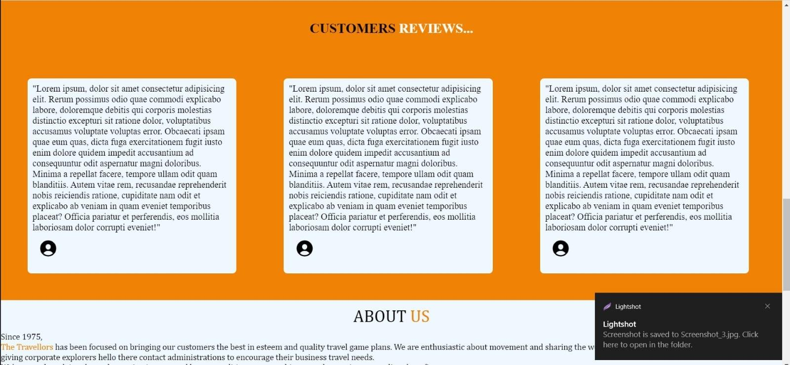

Slide 9
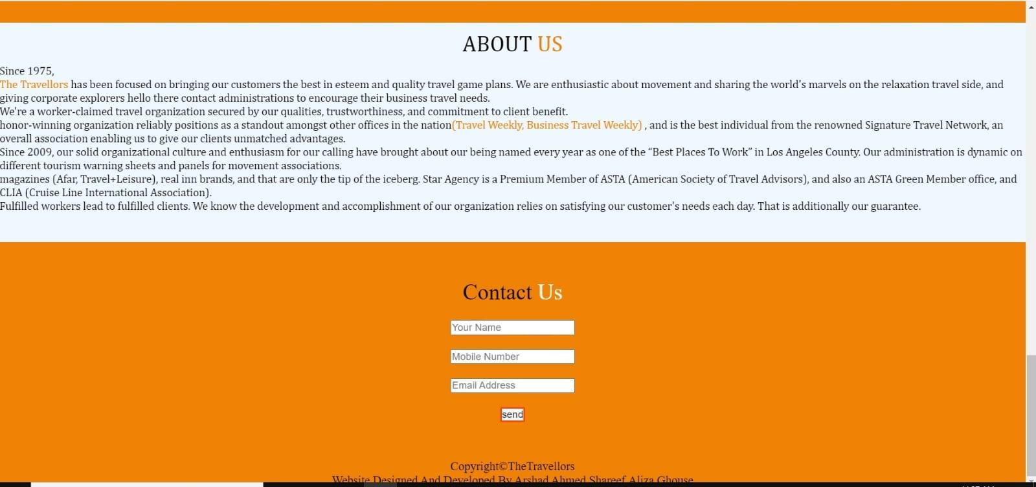

Slide 10
THANK YOU

